Slide 1

CHALLENGING FUNDING CUTS: SOME CASE STUDIES
HELEN MOUNTFIELD QC, MATRIX

Slide 2
SOUTHALL BLACK SISTERS
Challenge to changed funding criteria for domestic violence services
New criteria required bidders to target services at all (female) victims
Effectively precluded SBS from bidding

Slide 3
STRATEGY
Claimants were service users
Evidence explaining what service was and why it operated as it did and from service users about why they used the service and barriers to using others
Started promptly
EHRC intervention

Slide 4
GROUNDS
Breach of public sector equality duty
Failure to properly understand or follow Cohesion Guidance
Irrational approach to fostering good relations
Irrational approach to ‘equal access’

Slide 5
ATTACK ON CONTENT
Attacked substance of the analysis
But not in over-minute detail – core points
Getting the gist over to the judge

Slide 6
RESULT
2.30pm capitulation
Useful judgment on PSEDs
Very useful judgment on ability to fund organisations to meet needs of specific groups

Slide 7
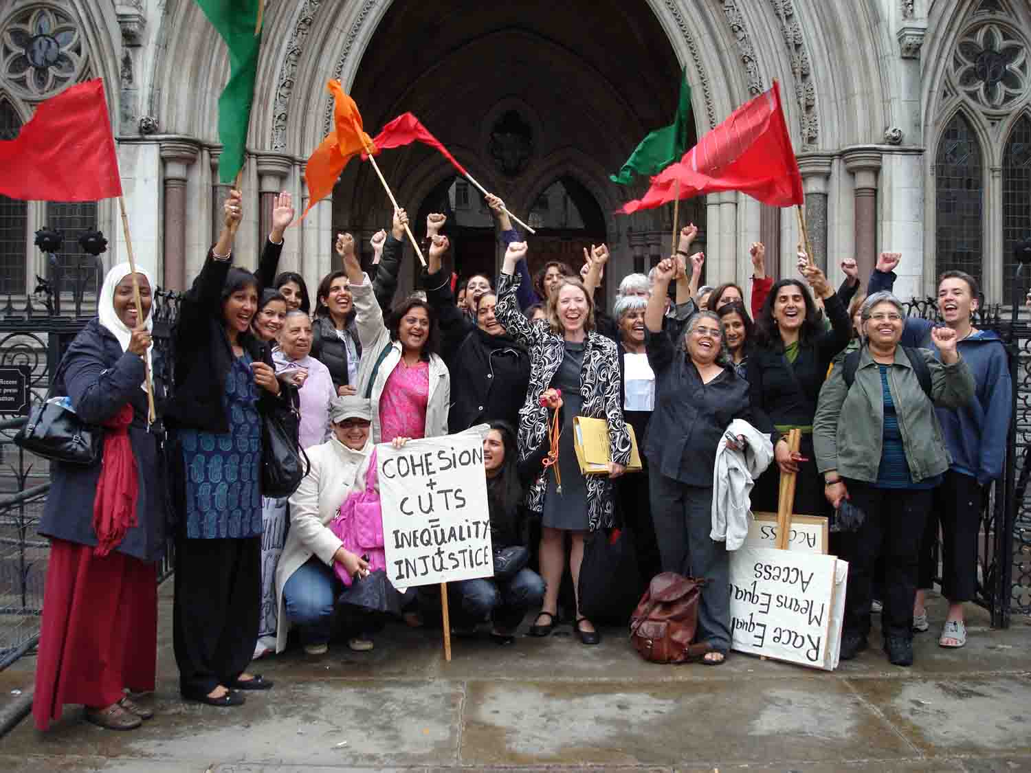
OUTCOME

Slide 8
LONDON COUNCILS
Localism + cuts = scope of LC funding radically reduced
Consultation on criteria for ‘pan-London’ services
BUT using existing commissioning categories a given

Slide 9

THE PROBLEM

Slide 10
STRATEGY
Problems of co-ordination/claimants
Timing – budget setting and Christmas
Claimants
Evidence from others

Slide 11
GROUNDS
Failure to consult fairly
Breach of public sector equality duty – inadequate consideration of differential impact on groups

Slide 12
OUTCOME
Budget not quashed
But categorisation decision was quashed
Re-configuration of funding cuts

Slide 13
LEGAL ENTITLEMENT ADVICE SERVICES, BIRMINGHAM
From grants to commissioning
‘Commissioning review consultation’
Unheralded decision to cease funding
pending re-commissioning ?? 10 months later

Slide 14
STRATEGY
Very urgent challenge
Claimants were service users
Explanation of impact

Slide 15
GROUNDS
Breach of Public Sector Equality Duty
Failure to consult
Failure to take all relevant considerations into account

Slide 16
OUTCOME
Victory
Restoration of funding – but only of organisations used by claimants
Reconfiguration of funding?

Slide 17
Contrasting cases
Bailey v Brent [2011] EWCA Civ 1586
R(Green) v Gloucestershire CC & R(Rowe & Hird) v Gloucestershire CC [2011] EWHC 2687 (Admin)

Slide 18
BRENT
EIA conscientious attempt;
Points complex and quite technical;
Main ‘hit you between the eyes’ issues identified
GLOUCESTERSHIRE & SOMERSET
Failure to identify the obvious issues in EIAs
Failure to undertake a sufficiently thorough evidence-gathering exercise
Failure of analysis

Slide 19

=

